Slide 1

Using Correlational Data to Uncover Hidden Inequalities in Education
by Spenser Vaughn

Slide 2

How can we create a better outcome for each child in America?
Research needs to be done to understand potential drivers of inequal outcomes in our schools.
Education stakeholders at the district and state levels can use this exploratory correlation analysis to identify further areas of research.

Slide 3
Data Summarization
Dataset is drawn from a combination of US Census data, NCES data, and NAEP test scores (4th grade & 8th grade).
Compiled by Roy Garrard
Notes:
National Center for Education Statistics
National Assessment of Educational Progress
Includes state/year identifier variables, revenue breakdowns, expenditure by category, student counts by grade level, and average test scores by state

Slide 4
Tested Hypotheses
We are focused on testing these two hypotheses:
h0: There is no correlation between reading test scores and any category of revenue.
h0: There is no correlation between math test scores and any category of expenditure.
Both hypotheses will be tested through correlation of test scores with appropriate aggregate data and subcategories.

Slide 5
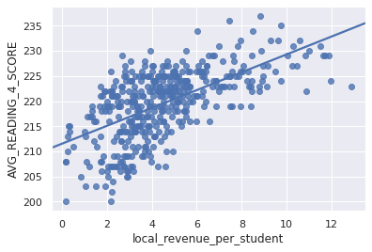
Revenue / Reading – 4th Grade
4th Grade Reading Test scores were tested for correlation with Local, State, Federal, and Total Revenues
Test score to local revenue correlation: +0.609 (p=.000)
All correlations statistically significant unless stated otherwise.
Notes:
Local revenue comes from a few different sources:
Property Taxes (by far the highest in almost all districts)
Local Donations
Municipal Taxes/Fees
Parcel/Land Taxes (e.g. Mello-Roos taxes in California)

Slide 6
Revenue / Reading – 4th Grade
Local Revenue has the strongest correlation with higher reading scores.
This is a significant driver of an education gap that needs to be addressed at the local and state level.
Test scores to state revenue correlation: +0.174 (p=.000)
Test scores to federal revenue correlation: -0.095 (p=.049)
Test scores to total revenue correlation: +0.504 (p=.000)
All correlations statistically significant unless stated otherwise.

Slide 7
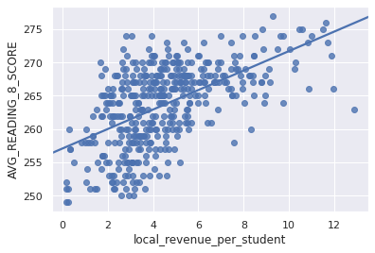
Revenue / Reading – 8th Grade
8th Grade Reading Test scores were also tested for correlation with Local, State, Federal, and Total Revenues
Test score to local revenue correlation: +0.562 (p=.000)
All correlations statistically significant unless stated otherwise.

Slide 8
Revenue / Reading – 8th Grade
Local Revenue has the strongest correlation with higher reading scores.
This source of an educational outcome gap persists in 8th grade data as well.
Test scores to state revenue correlation: +0.113 (p=.018)
Test scores to federal revenue correlation: -0.100 (p=.038)
Test scores to total revenue correlation: +0.434 (p=.000)
All correlations statistically significant unless stated otherwise.

Slide 9
Revenue / Reading Conclusions
Reject our null hypothesis!
Local revenue has the strongest correlation in both tested grade levels; even stronger than overall revenue!
All correlations are stronger in lower grade levels
Areas to explore further:
Federal Revenue / Test Score negative correlation
Root cause analysis of local revenue correlation
Notes:
Local revenue being the strongest correlational variable suggests factors associated with higher local revenue to also be connected to better reading test scores. These might include, but would not be limited to:
Better home environment
Access to additional resources outside of school
Access to more resources within the schools themselves
Lower odds of adverse environmental risks

Slide 10
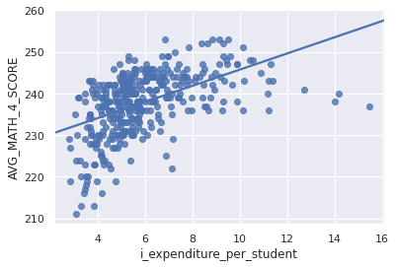
Expenditure / Math – 4th Grade
4th Grade Math Test scores were tested for correlation with Capital Outlay, Instruction, Support Services, Other, and Total Expenditures
Test score to instruction correlation: +0.501 (p=.000)
All correlations statistically significant unless stated otherwise.

Slide 11
Expenditure / Math – 4th Grade
Total Expenditure has the strongest correlation with higher math scores.
Instructors and Support Staff have similar correlations that suggest equal importance in learning outcomes.
Test scores to capital outlay expenditure: not significant
Test scores to support staff expenditure: +0.458 (p=.000)
Test scores to other expenditure: +0.244 (p=.000)
Test scores to total expenditure: +0.511 (p=.000)
All correlations statistically significant unless stated otherwise.

Slide 12
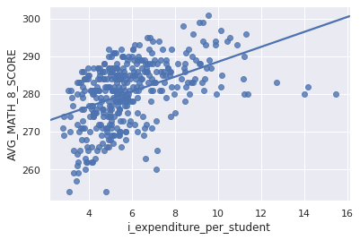
Expenditure / Math – 8th Grade
8th Grade Math Test scores were tested for correlation with Capital Outlay, Instruction, Support Services, Other, and Total Expenditures
Test score to instruction correlation: +0.459 (p=.000)
All correlations statistically significant unless stated otherwise.

Slide 13
Expenditure / Math – 8th Grade
Total Expenditure has the strongest correlation with higher math scores.
We have slightly higher dispersion compared to the 4th grade results.
Test scores to capital outlay expenditure: not significant
Test scores to support staff expenditure: +0.402 (p=.000)
Test scores to other expenditure: +0.107 (p=.033)
Test scores to total expenditure: +0.462 (p=.000)
All correlations statistically significant unless stated otherwise.

Slide 14
Expenditure / Math Conclusions
Reject our null hypothesis!
Total expenditure has the strongest correlation in both tested grade levels
Instructors and support staff are both highly correlated with higher math scores.
Not all expenditures have a measurable correlation with test scores!

Slide 15
General Conclusions
Based on the data, I think research efforts focused on potential causes of especially strong correlations might help boost education outcomes.
Education research needs to address inherent inequalities in outcomes that could be addressed by adjusting funding sources.
Looking at how outcomes and expenditures are correlated might enable school districts to make different budget allocation decisions in the future.

Slide 16
Future Research Steps
Obtaining district-level data to compare more directly between affluent districts and poorer districts
Gathering more granular financial data to see deeper breakdowns within each category

